Slide 1
Miniapps
study 2022

Slide 2




Miniapp concept?
Mini Program
Mini App
Super App
Application
Native App
Mobile
APP
OS

Slide 3
MiniApp Level 0
MiniApp Server
New
HTML
CSS
JS
Mini Program
Mini App
HTML
CSS
JS
HTML
CSS
JS
Super App
Application
Backend Server
Native App
Server
Mobile
APP
OS

Slide 4
MiniApp Level 2
MiniApp Server
New
1- Text View
4- Control → Web View
This is a call from+ link.
<!DOCTYPE html>
<html>
<head>
<title>Page Title</title>
</head>
<body>
<h1>This is a Heading</h1>
<a onClick=“GetLink (“link1”)”>This is a paragraph.</a>
<script>
function GetLink (link)
{
JS.GetLink(link);
}
document.getElementById("demo").innerHTML = myFunction(4, 3);
</script>
</body>
</html>
HTML
CSS
JS
2- Class → Start App
Run App
HTML
CSS
JS
Inject JS.java()
MainActivity.java
3- Class → “JS bridge”
GetLink(link)
JS.java

Slide 5
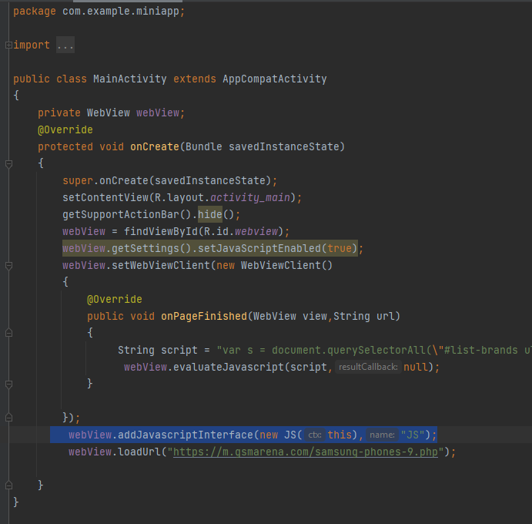
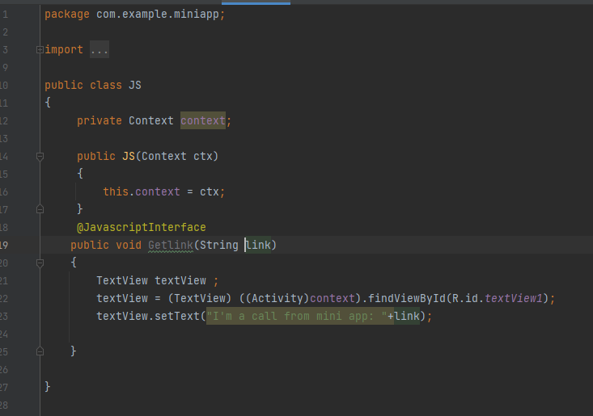
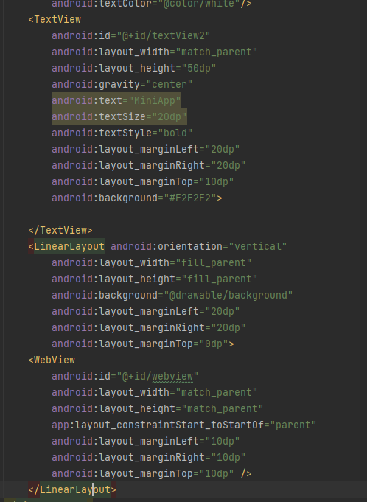
Code Snippet
Start App
JS bridge
Design

Slide 6
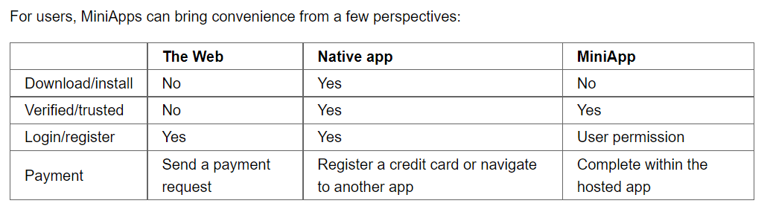
Advantages of miniapps
You need only to trust a single entity (Imagine: Google, Microsoft, Banking,…..)
It changed the traditional way of downloading, installing, and logging into the app.(One identity)
Mobile device features are shared between miniapps.
Data integration between different apps is easier (frontend/backends).

Slide 7
Resources
https://www.w3.org/TR/mini-app-white-paper/
https://github.com/BugsCleaners/Android
https://www.youtube.com/watch?v=3jZ4dMeJR1A&t=302s

